Slide 1
SECURE DATA HIDING IN IMAGES USING STEGNOGRAPHY
CAPSTONE PROJECT
Presented By: JESS JOHNSON GONSALVES
Student Name : JESS JOHNSON GONSALVES
College Name & Department : ST. FRANCIIS INSTITUTE OF TECHNOLOGY

Slide 2
OUTLINE
Problem Statement
Technology used
Wow factor
End users
Result
Conclusion
Git-hub Link
Future scope

Slide 3
Problem Statement
The problem of secure data hiding in images using steganography focuses on developing techniques to embed sensitive information within digital images without detection. As cyber threats increase, traditional data protection methods are often insufficient. This project aims to create a robust steganographic system that ensures data confidentiality while maintaining image quality, providing a secure and undetectable means of data transmission and storage. The challenge is to balance security with imperceptibility, ensuring that the hidden information remains protected against unauthorized access.

Slide 4
Technology used
Platform used: Python
Libraries used: CV2

Slide 5
Wow factors
The "Secure Data Hiding in Images Using Steganography" project stands out due to its integration of advanced security algorithms, ensuring dual protection for hidden data. It focuses on maintaining image quality and high imperceptibility, while being robust against attacks like compression or cropping. The use of adaptive data embedding methods improves both capacity and security, making it suitable for real-world applications like secure communication and covert data transfer.

Slide 6
End users
The end users for "Secure Data Hiding in Images Using Steganography" include:
Government and Military Organizations: For secure communication and protecting sensitive data from
unauthorized access or interception.
Cybersecurity Professionals: To enhance data protection and prevent unauthorized data extraction during
transmission or storage.
Businesses and Enterprises: For safeguarding confidential information, intellectual property, and trade
secrets when sharing files online or via less secure networks.
Researchers and Academics: In the fields of cryptography, digital forensics, and privacy, who require secure
methods for hiding and transmitting data.
Individuals Concerned with Privacy: People who want to protect personal information from prying eyes,
especially when sharing data over unsecured channels.
Media and Content Creators: For watermarking digital content, such as images or videos, to protect
copyright and prevent unauthorized distribution.

Slide 7

Results

Slide 8
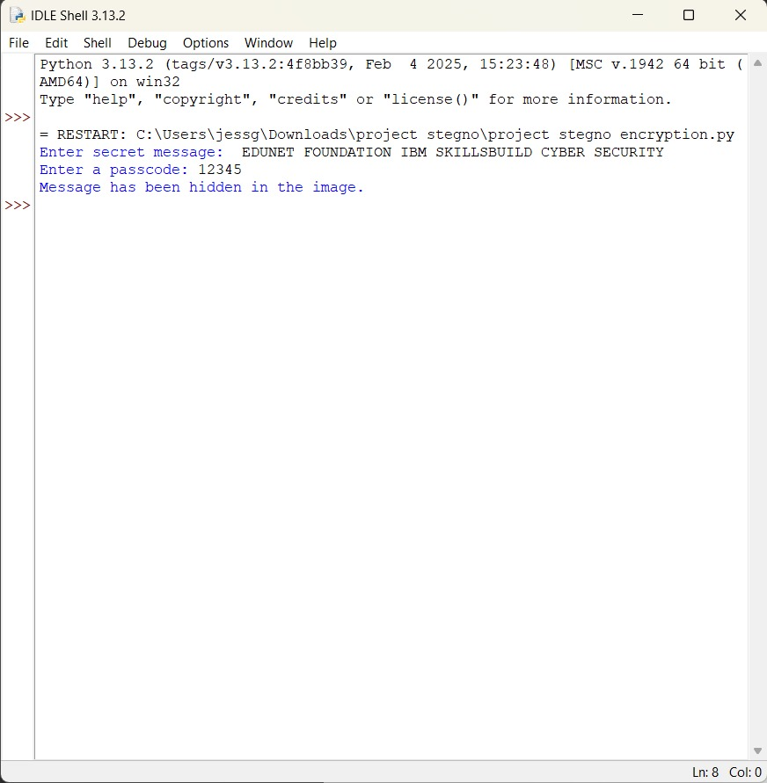
Results

Slide 9
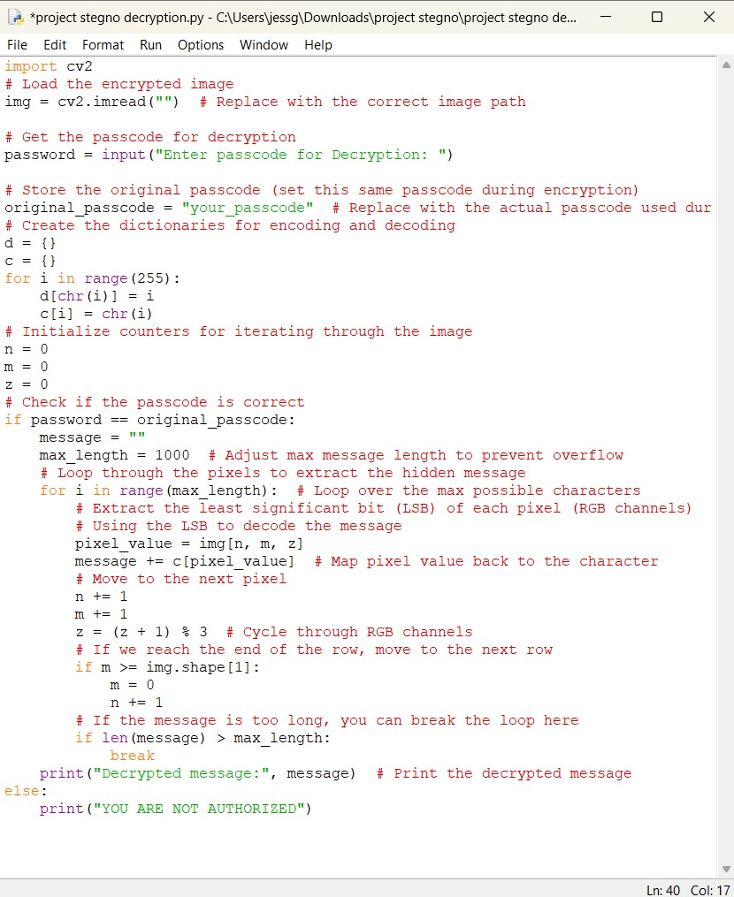
Results

Slide 10
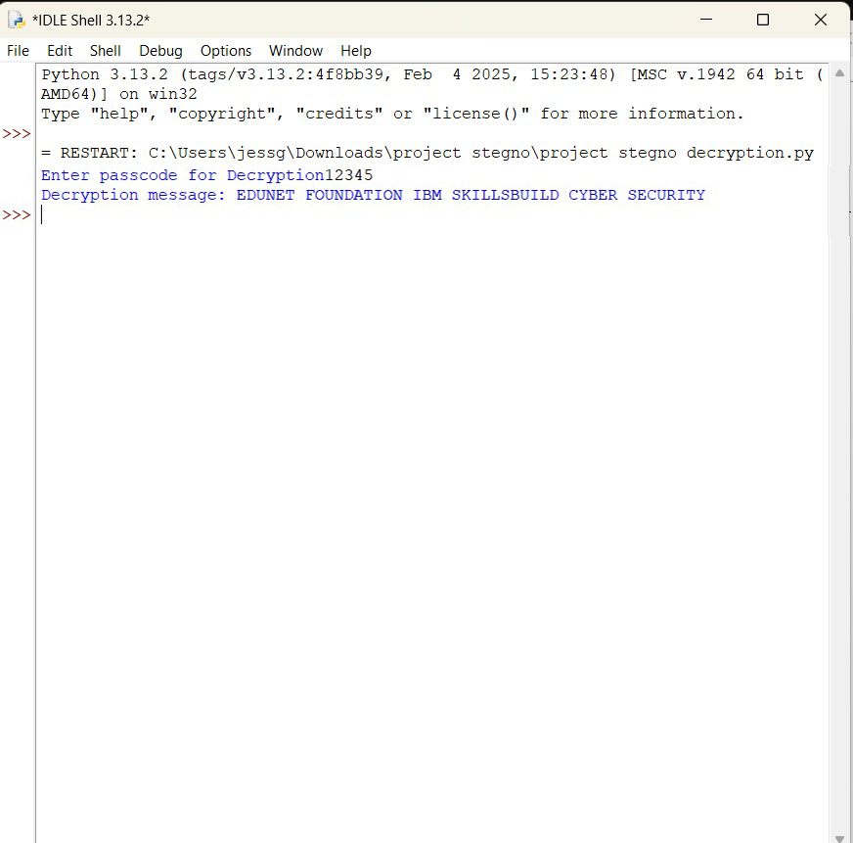
Results

Slide 11
Conclusion
In conclusion, the "Secure Data Hiding in Images Using Steganography"
project solves the problem of protecting sensitive information by hiding it in images
in a way that is both secure and hard to detect. By combining encryption with
steganography, the data remains safe and invisible, even if the image is altered.
The system is designed to withstand attacks and still keep the image quality intact,
making it a reliable solution for secure communication and storage. This project
provides a practical way to protect data in areas where privacy and security are
important.

Slide 12
GitHub Link
https://github.com/Jess14g/Stegnography-Project.git

Slide 13
THANK YOU

